Slide 1
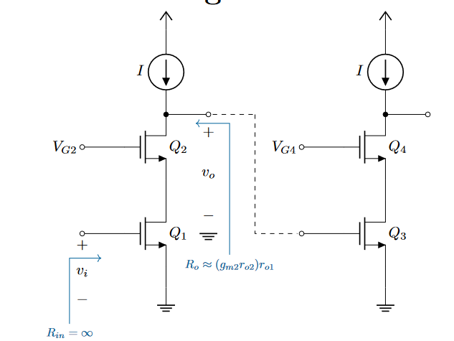
CircuiTikz Tutorial
Daan Dekker &
Karsten Stolk
IEEE SBE Eindhoven 2023

Slide 2





CircuiTikZ in 5 parts
Background
Skills
Example I
Example II
Challange

Slide 3
What is TikZ?
Graphics the LaTeX Way!
    - Precise positioning, consistency, macros, excellent typography
    - ‘Brick Wall’ learning curve
TikZ translates simple commands (vector graphics operations) into portable lower-level commands.
Many, many, many additional packages doing everything you could possibly want. (calendars, mind maps, plots, circuits)
Background
Skills
Example I
Example II
Challange

Slide 4
CircuitTikZ
A TikZ extensions that enables drawing Circuits!
Really just a ( super ) fancy set of macros…
4
Background
Skills
Example I
Example II
Challange

Slide 5
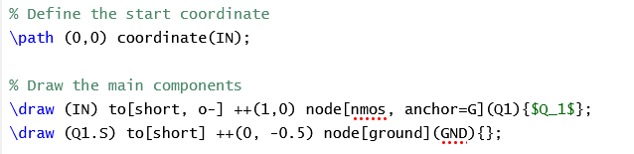
Paths
Syntax
    - (0,0) – (1,1) – (3,5)
    - Fill, shade, clip, resistor, capacitor, ...
    - Paths can have key-value options
Actions
Background
Skills
Example I
Example II
Challange

Slide 6
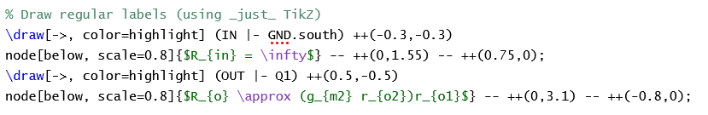
Nodes
    - Nodes have position, text, and a label
    - Different types exist (circle, rectangle, nmos, etc)
    - Can later be used for positional reference
  This is only a short summary, RTFM for a proper reference. TikZ is massive.
Background
Skills
Example I
Example II
Challange

Slide 7
Coordinates
- Absolute Page Coordinates (1cm, 1pt)
- TikZ Coordinate System (1, 1) / (1, 1, 0)
- Polar Coordinates (30, 1cm)
- Barycentric ???
- (Custom) nodes as reference (nmos.G)
- Incremental coordinates ++(1, 1) / +(1, 1)
- Intersection-based (intersection cs: first line={(A)--(B)},
second line={(C)--(D)})
  - Perpendicular (p |- q)
- And even more (custom even), RTFM
Background
Skills
Example I
Example II
Challange

Slide 8
How does this relate to CircuiTikz again?
Use Paths to draw short-circuits, wires, 2-port components like diodes, resistors, etc.
Use nodes for >2-port components like transistors, etc
Use the coordinate and (custom) node systems to make reusable, easily reflowable designs!
Background
Skills
Example I
Example II
Challange

Slide 9
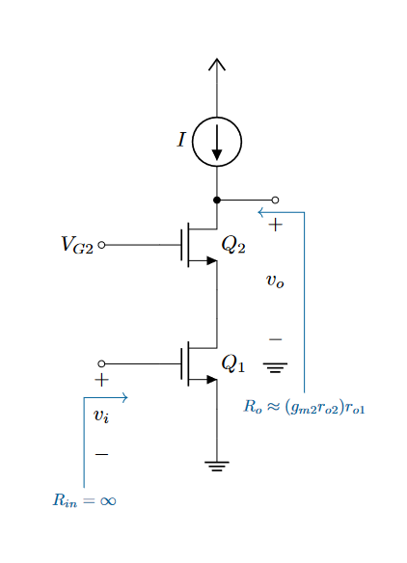
Example 1: A N-MOS Cascode Amplifier
Simple Transistor Circuit
Shows Basic Nodes / Paths
Shows Coordinate Usage
Background
Skills
Example I
Example II
Challange

Slide 10

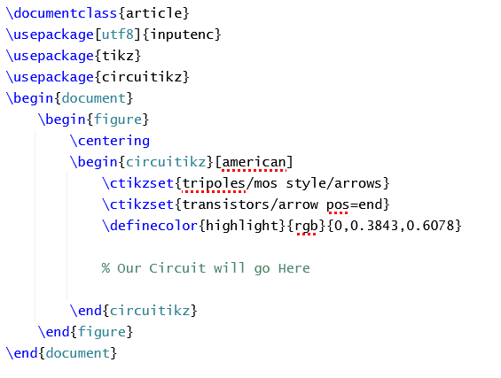
Step 1: Setting-up the environment
Background
Skills
Example I
Example II
Challange

Slide 11
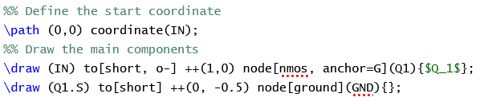
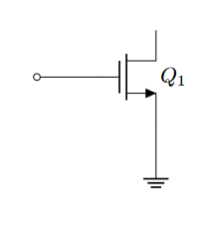
Step 2: Transistor Q1
Background
Skills
Example I
Example II
Challange

Slide 12
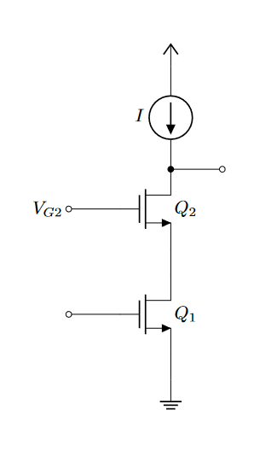
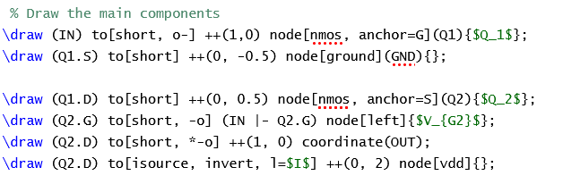
Step 3: Transistor Q2, current source
Background
Skills
Example I
Example II
Challange

Slide 13
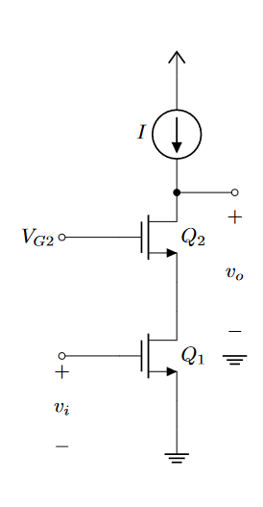
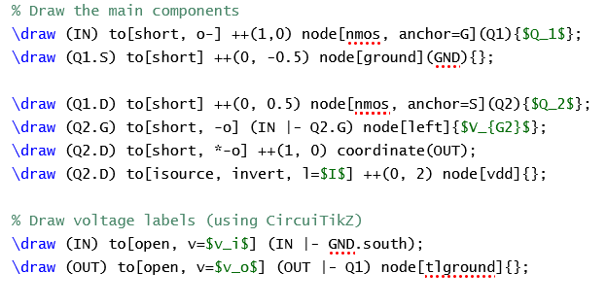
Step 4: Voltage labels
Background
Skills
Example I
Example II
Challange

Slide 14
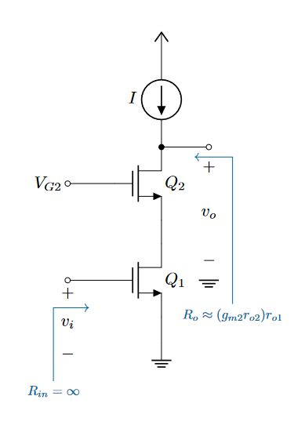
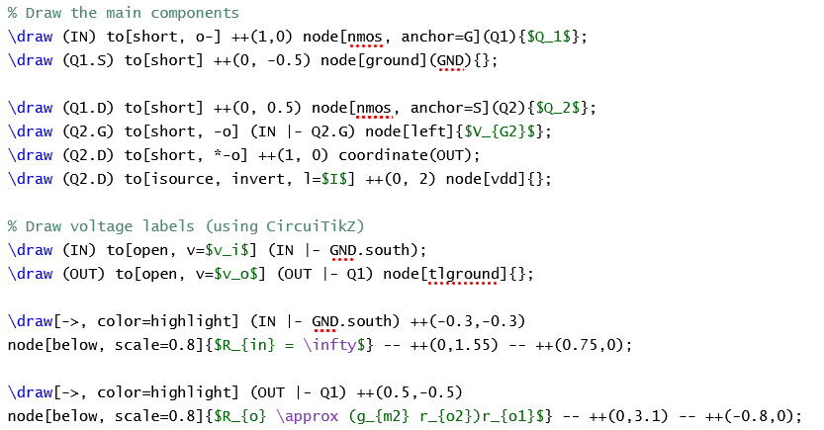
Step 5: Circuit Annotations
Background
Skills
Example I
Example II
Challange

Slide 15

DONE!

Slide 16

But Wait…
What if we want to add an extra stage?
Luckily, we made a reusable circuit!

Slide 17
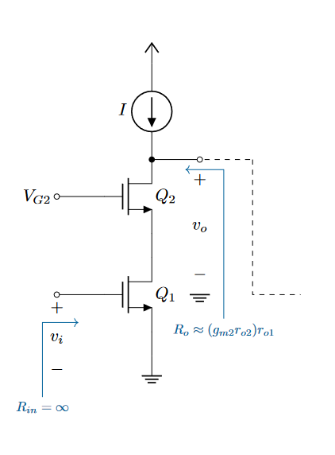

Step 6: Preparing to Copy-Paste
Background
Skills
Example I
Example II
Challange

Slide 18
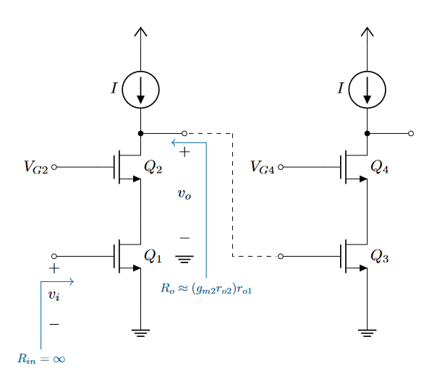
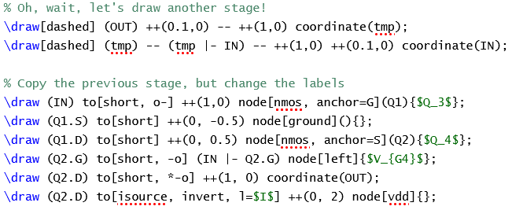
Step 7: Copy-Paste!
Background
Skills
Example I
Example II
Challange

Slide 19
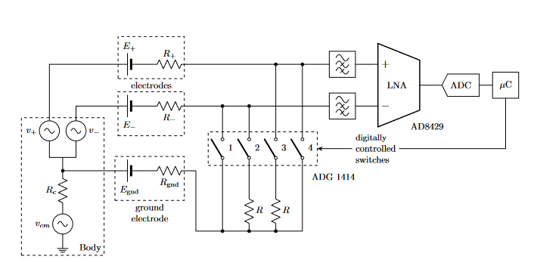
Example 2: A sensing system
- Complicated System
- ‘Weird’ components
- TikZ libraries
Based on the CircuiTikz Manual, Version 1.6.0
Authors:
Massimo A. Redaelli (m.redaelli@gmail.com)
Stefan Lindner (stefan.lindner@fau.de)
Stefan Erhardt (stefan.erhardt@fau.de)
Romano Giannetti (romano.giannetti@gmail.com)
Adapted to fit the presentation style
Background
Skills
Example I
Example II
Challange

Slide 20
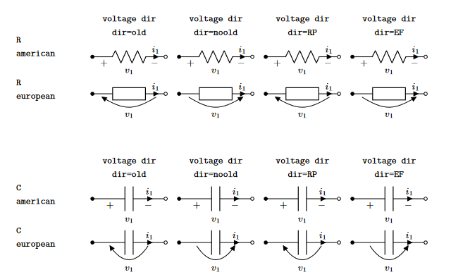
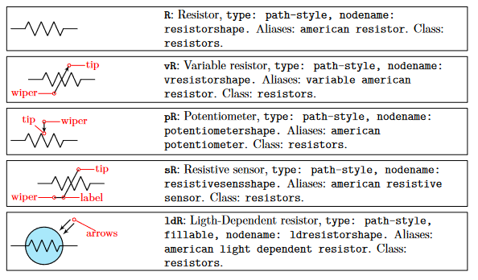
RTFM
List of Components and Anchors
Extra Options for Labels
Background
Skills
Example I
Example II
Challange

Slide 21
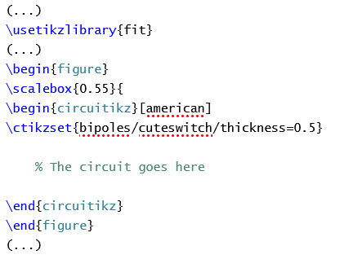
Step 1: Set-Up
Background
Skills
Example I
Example II
Challange

Slide 22
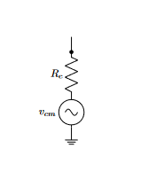
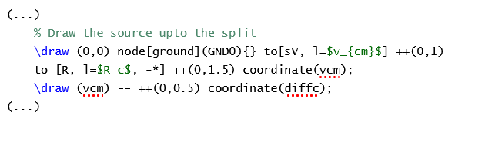
Step 2: The Start
Background
Skills
Example I
Example II
Challange

Slide 23
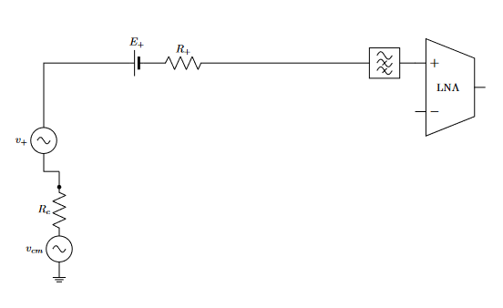
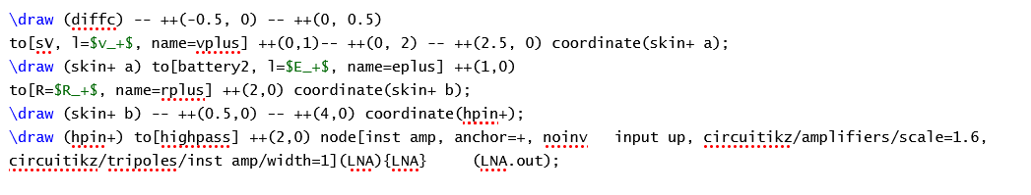
Step 3: The Upper Line
Background
Skills
Example I
Example II
Challange

Slide 24
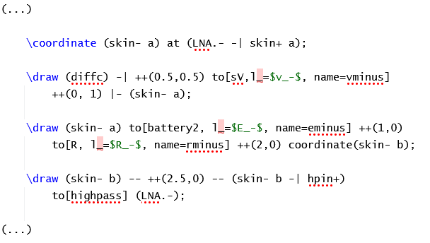
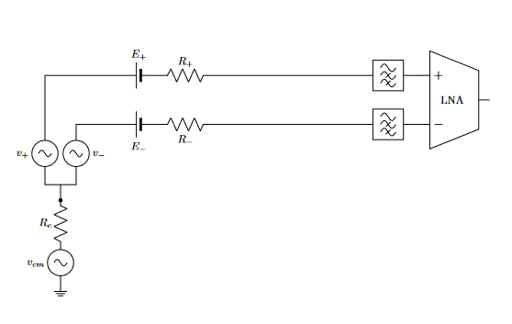
Step 4: The Lower Line
Background
Skills
Example I
Example II
Challange

Slide 25
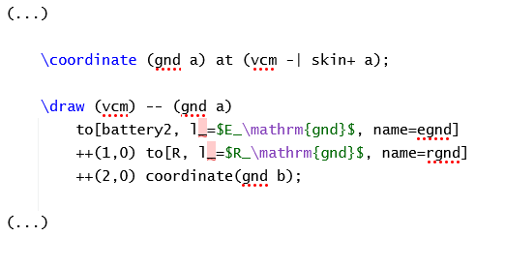
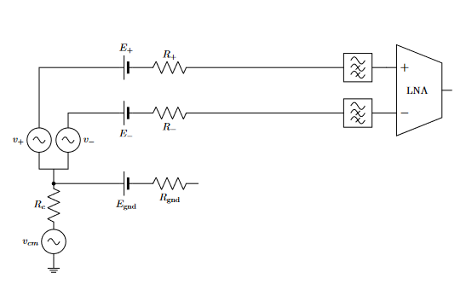
Step 5: The lowest line
Background
Skills
Example I
Example II
Challange

Slide 26
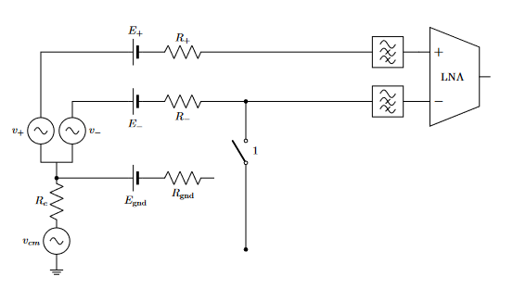
Step 6: The first switch
(...)
\def\swdown{-3.2}
\draw (skin- b) ++(1,0) coordinate(sw1);
\draw (sw1) to[cosw, invert, mirror, l=1, *-, name=s1] ++(0,\swdown) to[short, -*] ++(0, -1.5);
(...)
Background
Skills
Example I
Example II
Challange

Slide 27
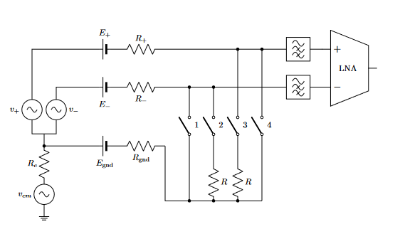
Step 7: The rest of the switches
(...)
\draw (sw1) ++(1,0) coordinate(sw2);
\draw (sw2) to[cosw, invert, mirror, l=2, *-] ++(0,\swdown) to[R=$R$, -*] ++(0, -1.5);
\draw (sw2|-skin+ b) ++(1,0) coordinate(sw3);
\draw (sw3) to[short, *-] (sw3|-sw2)
to[cosw, invert, mirror, l=3,] ++(0,\swdown)
to[R=$R$, -*] ++(0, -1.5);
\draw (sw3) ++(1,0) coordinate(sw4);
\draw (sw4) to[short, *-] (sw4|-sw2)
to[cosw, invert, mirror, l=4, name=s4] ++(0,\swdown) to[short] ++(0, -1.5) coordinate(endsw);
\draw (gnd b) |- (endsw);
(...)
Background
Skills
Example I
Example II
Challange

Slide 28
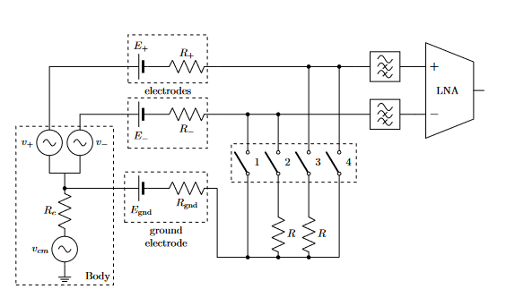
Step 8: Boxes!
(...)
\node[rectangle, draw, dashed, fit=(GND0) (vplus) (vpluslabel) (vminuslabel)] (body) {};
\node[anchor=south east, align=center] at (body.south east) {Body};
\node[rectangle, draw, dashed, fit=(rplus) (eplus) (epluslabel) (rpluslabel)] (top) {};
\node[rectangle, draw, dashed, fit=(eminus) (rminus) (eminuslabel) (rminuslabel)] (bot){};
\node[anchor=center, align=center] at ($(top.south)!0.5!(bot.north)$) {electrodes};
\node[rectangle, draw, dashed, fit=(egnd) (rgnd) (egndlabel) (rgndlabel)](gnd){};
\node[below, align=center] at (gnd.south) {ground\\ electrode}; \node[rectangle, draw, dashed, fit=(s1) (s4label), inner ysep=8pt](switches){};
(...)
Background
Skills
Example I
Example II
Challange

Slide 29
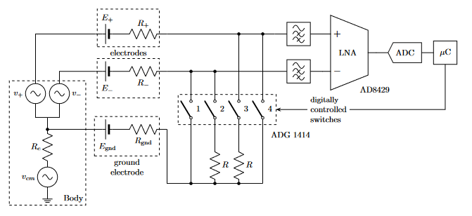
Step 9: Final touches
(...)
\draw (LNA.out) -- ++(0.5,0) node[msport,circuitikz/RF/scale=2](ADC){ADC};
\draw (ADC.right) -- ++(0.5,0)
node[twoportshape, anchor=left, t=$\mu$C](uC){};
\draw (uC.south) -- (uC.south |- switches.east) -- ++(-4,0)
node[align=left, anchor=east](DCS)
{\small digitally\\ controlled\\ switches};
\draw[-Stealth] (DCS.west) -- (switches.east);
\node [anchor=north west] at ([xshift=-10pt, yshift=-5pt] switches.south east) {ADG 1414};
\node [anchor=north west] at ([yshift=-5pt]LNA.refv down) {AD8429};
(...)
Background
Skills
Example I
Example II
Challange

Slide 30
DONE!

Slide 31
But Wait…
The IC guys made a mess, and the electrodes should include an inductor…
Luckily, (…)

Slide 32
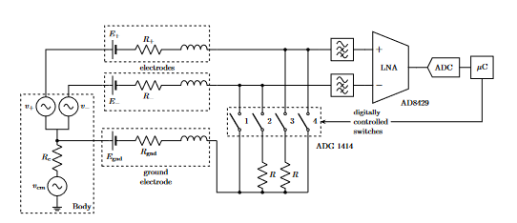
Step 10: Make 6 small changes
(...)
% 1 Add the inductors after the resistors, but before the ‘b’ nodes
to[L, name=lplus] ++(2,0)
to[L, name=lminus] ++(2,0)
to[L, name=lgnd] ++(2,0)
% Add the names of the inductors to the boxes
% so they fit
(...)
Background
Skills
Example I
Example II
Challange

Slide 33
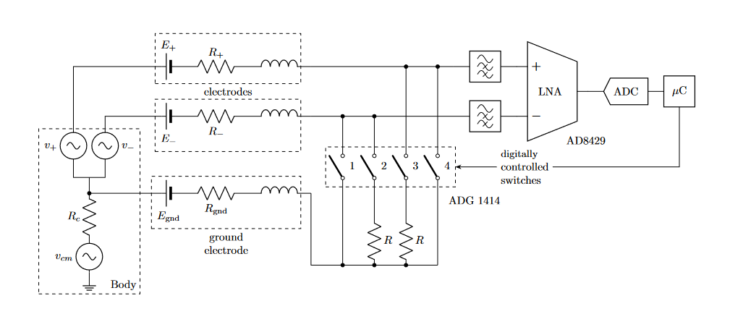
The result
Background
Skills
Example I
Example II
Challange

Slide 34
Your Turn!

Slide 35
Please Recreate, Fully, This Circuit:
Background
Skills
Example I
Example II
Challange

Slide 36
DONE!

Slide 37
But Wait…
(...)

Slide 38
Change the circuit to the following
Background
Skills
Example I
Example II
Challange

Slide 39
The End.
Please don’t ask questions, RTFM.

